Slide 1
Ruby Fundamentals with a focus on blocks
Wifi:
Password:

Slide 2
Overview
1 – Quick Ruby basics
2 – Blocks and Iterators

Slide 3
1 – Quick Ruby Basics
Numbers
Strings
Objects and message-passing
Arrays
Hashes and Symbols
Green text = irb input red text = irb output
Notes:
So if everyone who wants to follow along is ready to do so then I’ll dive right into the concepts.
I’ll go over this list of 6 concepts one by one, first providing a brief overview of what the concept means in the context of the Ruby language, followed by examples of how that concept works in action.
The green text is the input I’ve provided into irb, or the Interactive Ruby Shell, which is at tool to interactively execute Ruby expressions , and the red text is the output of irb.

Slide 4
Quick Ruby Basics: Numbers
Integers
No decimal points
Examples: 0 88 123456789
Floating-point numbers (“floats”)
Do have decimal points
Examples: 2.6 0.5 10.09875
Notes:
In Ruby, there are two kinds of numbers: Integers and floating-point numbers or, more simply, floats
Integers are numbers without decimal points. They are just a sequence of digits like 0, 88, etc.
Floats are numbers WITH decimal points (you must place at least one digit before the decimal point).

Slide 5
Quick Ruby Basics: Numbers
print 88 / 2
44 => nil
print 88 % 6
4 => nil
print 88.0 / 2.0
44.0 => nil
print 88.0 % 6.0
4.0 => nil
Notes:
For the numbers exercise, we’ll do some simple math.
The print statement allows us to run all four lines at once but separately so it doesn’t think it’s all part of the same code block—in which case it would only return the last statement it evaluates.
The percent sign is called the MODULO operator, which shows the remainder when the first number is divided by the second number. So 4 is the remainder of 88 / 6

Slide 6
Quick Ruby Basics: Strings
Lines of text composed of characters
Examples:
"You’re safe and sound now. Back in good old 1995."
"I'm George. George McFly. I'm your density."
"88"
"true"
Notes:
Strings are characters inside quotes.
Note that I used double quotes in the first and second strings because I used a single quote

Slide 7
Quick Ruby Basics: Strings
Press ENTER after typing in each of these literal strings in the console:
"I’m George. "
=> "I'm George"
"George McFly."
=> "George McFly."
Concatenate (join) those literal strings:
"I’m George. " + "George McFly."
=> "I’m George. George McFly."
Notes:
Let’s start exploring strings by typing, in quotes, “I’m George [note that there is a space after the period and before the second quote]” and then press enter.
Then type in “George McFly.” and press enter.
Then let’s concatenate (or, join) those literal strings using the plus sign operator. Note that, again, we need the space after the period in the first string.

Slide 8
Quick Ruby Basics: Strings
Now we can build up the same string via interpolation using the special syntax:
#{ }
to assign values to variables .
Assign a value to the made-up variable, first_name:
first_name = "George"
=> "George"
"I’m #{first_name}. #{first_name} McFly."
=> "I’m George. George McFly."
Notes:
Now we can build up the same string using interpolation, through the special syntax of the hash sign and curly braces.
This way we can assign values to any variable that we want to make up, in case we want to use that variable over and over inside an app without having to explain to Ruby what it is each time. Ruby will remember it for us.
______
One of the ways this concept is used is when you log into a site like Amazon and it says “Hello, Erin” in the top corner and then your name appears again when you go to check out, etc.

Slide 9
Quick Ruby Basics: Strings
last_name = "McFly"
=> "McFly"
"I’m #{first_name}. #{first_name} #{last_name}."
=> "I’m George. George McFly."
Interpolation requires double-quoted strings.
Notes:
We can also assign a value to George’s last name with the variable last_name.
First, we tell Ruby what the value of the variable last_name is (in this case, McFly).
Then we interpolate the variable first_name and last_name into the string, “I’m first name. First name last name.” or … [[reveal result]] “I’m George. George McFly.”
Another quick note: Ruby supports both single quoted and double quoted strings, but interpolation requires double-quoted strings. If you were to use single quotes then it would return the special character combination instead of its value.

Slide 10
Quick Ruby Basics: Objects and Message-passing
Everything in Ruby is an object, including strings.
Objects respond to messages.
Example:
"flux capacitor".length
=> 14
Notes:
Now we’ll discuss objects and message-passing.
Everything in Ruby is an object, including strings. I won’t go into depth about objects because you can best understand the concept of a Ruby object by seeing a lot of examples of them.
You can also understand them by seeing what they DO, which is respond to messages.
For example, an object like a string can respond to the message LENGTH…
…which returns the number of characters in the string.
The string FLUX CAPACITOR has 14 characters.

Slide 11
Quick Ruby Basics: Objects and Message-passing
Messages passed to objects are METHODS.
.empty? method indicates that the return value is boolean:
true or false
"flux capacitor".empty?
false
"".empty?
true
Notes:
Typically the messages that get passed to objects are called METHODS.
Strings also respond to the EMPTY method, which indicates that the return value is BOOLEAN, or true/false
The string, flux capacitor is not empty… so Ruby returns a value of false.
The string of only quotes is empty… so Ruby returns a value of true

Slide 12
Quick Ruby Basics: Objects and Message-passing
s = "flux capacitor"
if s.empty?
"String is empty. Flux capacitor is dead."
else
"String is nonempty. Flux capacitor is on!"
end
=> "String is nonempty. Flux capacitor is on!"
Notes:
Booleans are especially useful for control flow, or how Ruby chooses a path through your program, as we see here with this IF / ELSE statement.
An IF / ELSE statement says to Ruby: "If this expression is true, run this code block;
… otherwise, run the code after the else statement."
Since the string is not empty, we get this result…

Slide 13
Quick Ruby Basics: Objects and Message-passing
Combine booleans using operators:
&& (“and”)
|| (“or”)
! (“not”)
Notes:
Booleans can also be combined using the
&& (“and”)
|| (“or”),
! (“not”)
operators

Slide 14
Quick Ruby Basics: Objects and Message-passing
x = "Marty McFly"
=> "Marty McFly"
y = ""
=> ""
print "Both strings are empty" if x.empty? && y.empty?
nil
print "One of the strings is empty" if x.empty? || y.empty?
"One of the strings is empty" => nil
Print "The string ‘#{x}’ is not empty" if !x.empty?
”The string ‘Marty McFly’ is not empty” => nil
Notes:
Here we can see these operators in action.
First we define the variable X as Marty McFly, in double quotes.
…Then we define the variable Y as an empty string—just double quotes.
…Then we say, print “both stings are empty” IF x is empty AND y is empty.
…Because x is not empty, we get a value of nil
…Then we say, print “One of the strings is empty” IF x is empty OR y is empty
…. Because one of the strings is indeed empty, we get our string back
…Finally we say, print “The string x is not empty” IF x is NOT empty
…. And because x has content and is not empty, we get our interpolated string in return

Slide 15
Quick Ruby Basics: Arrays and Ranges
An array is a list of elements in a particular order.
Example:
a = [1985, 1955, 2015]
[1985, 1955, 2015]
To get from a string to an array, use the .split method
"Marty Doc Biff Jennifer".split
=> [“Marty”, “Doc”, “Biff”, “Jennifer”]
Notes:
Now we’ll talk about ARRAYS, which are just elements in a particular order
… such as the years in Back to the Future
…To get from a string to an array, we can use the .split method, which divides a string by splitting on whitespace.
… The result of this operation is an array of 4 strings

Slide 16

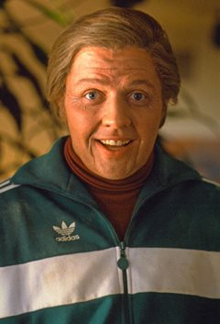
Quick Ruby Basics: Arrays and Ranges
a = ["Marty", "Doc", "Biff", "Lorraine"]
a = [“Marty”, “Doc”, “Biff”, “Lorraine”]
a[0]
“Marty”
a[2]
=> “Biff”
Notes:
Ruby arrays are zero-offset, which means that the first element in the array has index 0, the second has index 1, and so on…
…so in this array, in index place 0
… is Marty
… and in index place 2
… is Biff

Slide 17
Quick Ruby Basics: Arrays and Ranges
a = ["Marty", "Doc", "Biff"]
a = [“Marty”, “Doc”, “Biff”]
a.include?(“Doc”)
true
a.sort
[“Biff”, “Doc”, “Marty”]
a.reverse
[“Marty”, “Doc”, “Biff”]
a.shuffle
[“Doc”, “Marty”, “Biff”]
a.join
=> “MartyDocBiff”
a.push("Jennifer")
a = [“Marty”, “Doc”, “Biff”, “Jennifer”]
Notes:
Since an array is an object in Ruby, it responds to the method .split, as we just saw, and to a bunch of other methods, such as ….
… include
…sort (which alphabetizes the elements or puts them in numerical order)
…reverse (which does the opposite)
…shuffle
…join
…and push (which adds a specified element –in this case the string Jennifer—to the end of the array)

Slide 18
Quick Ruby Basics: Arrays and Ranges
A range converted to an array:
(0..9).to_a
[0, 1, 2, 3, 4, 5, 6, 7, 8, 9]
Ranges also work with characters:
(’a'.. ’e').to_a
=> ["a", "b", "c", "d", "e"]
Notes:
Closely related to arrays are ranges, which can probably most easily be understood by converting them to arrays using the to_a method:
… In this example, we’re using parentheses to call the to_a method on the range, 0 to 9.

Slide 19
Quick Ruby Basics: Hashes and Symbols
Hashes = Arrays that aren’t limited to integer indices.
Hash indices = keys. They can be almost ANY object.
user = {}
{}
user["first_name"] = "Marty"
”Marty”
user["last_name"] = "McFly"
”McFly"
user["first_name"]
”Marty"
user
{"last_name"=>”McFly", "first_name"=>”Marty"}
Notes:
Our final topic is hashes and symbols. Hashes are basically arrays that aren’t limited to integer indices.
… Instead, hash indices, or keys, can be almost any object.
… For example, we can use strings as keys:
…we have an empty hash to start (as you can see, the hash is indicated with curly braces
…now, let’s add some key-value pairs to the hash so that it’s no longer empty)
…to the key first_name we assign a value of Marty
…to the key last_name we assign a value of McFly
..Then we can access first_name just as we would with arrays
…and typing just the name of the hash gives us its literal representation
Although hashes resemble arrays, one important difference is that hashes don’t generally guarantee keeping their elements in a particular order. If order matters, use an array.

Slide 20
Quick Ruby Basics: Hashes and Symbols
Simplify with hashrockets
=>
user = {"first_name”=>"Lorraine", "last_name”=>"McFly”}
{"last_name"=>"McFly", "first_name"=>"Lorraine"}
Symbols
This is a string "Marty"
This is a symbol :Marty
Notes:
But all of that’s a lot of work. Instead of defining hashes one item at a time using square brackets, it’s easy to use a literal representation with keys and values separated by a “hashrocket” as you can see between the key first_name and Lorraine and between last_name and McFly.
...In these 2 examples we’ve used strings as hash keys, but in Rails it is much more common to use symbols instead.
…Symbols look kind of like strings
…but they start with a colon and aren’t surrounded by the baggage of quotes
…and unlike strings, you can’t use all characters. You have to start the symbol with a letter (not a number, for example) and then stick to normal word characters.

Slide 21
Quick Ruby Basics: Hashes and Symbols
user = { :name => "George McFly", :email => "geo@me.com" }
=> {:name=>”George McFly", :email=>”geo@me.com"}
user[:name]
=> ”George McFly"
user[:password]
nil
user = { :name => "Biff", :email => "biff@gmail.com" }
is the exact same as
user = { name: "Biff", email: "biff@gmail.com" }
Notes:
As with arrays and ranges, hashes respond to the each method. For example, consider a hash named flash…
…with keys for two conditions, :success and :danger:
[[show all green text of the code, all the way to END]]
…Note: while the each method for arrays takes a block with only one variable, the each method for hashes takes two, a key and a value. Thus, the each method for a hash iterates through the hash one key-value pair at a time. This example also uses the INSPECT method, which returns a string with a literal representation of the object it’s called on.
SO the result of this operation is that is has printed the string, “Key, success, has a value of the string, great scott it worked” … and the key, danger, has a value of the string, “run for it marty”

Slide 22
Blocks
A block is…
a sequence of one or more executable Ruby statements
Notes:
Arrays and ranges respond to lots of methods that accept blocks, which are one of Ruby’s most powerful and most confusing features.
…The basic definition of a block is just a sequence of one or more executable Ruby statements.
Basically, with Ruby blocks, you can group a set of instructions together.

Slide 23
Blocks without variables
iterator
⬇
3.times { print ”Can we please go get burgers? " }
⬆
block
Notes:
The convention is to enclose one-line blocks in curly braces, like this simple example.
The block is everything inside the curly braces, i.e., the method PRINT with the string inside quotes
The iterator here is TIMES. In general, an iterator is simply a method that can invoke a block of code repeatedly.
Here, TIMES calls the block once for each value between 0 and the value of its caller, which is 3

Slide 24
Blocks without variables
Can we please go get burgers? Can we please go get burgers? Can we please go get burgers? => 3
Notes:
So typing this into IRB gives us this result—it prints the string 3 times,
And then returns the caller, which is the number 3.

Slide 25
Blocks without variables
A block with no variables:
3.times { puts ”I’m hungry!" }
I’m hungry!
I’m hungry!
I’m hungry!
=> 3
Notes:
Here’s a similar example in which TIMES calls the block that uses the PUT-STRING, or PUT-S, “I’m hungry”, 3 times

Slide 26
Blocks without variables
2.times do
print "We would like to invite you to no longer live with us. "
print "At first I did not know it was your diary, I thought it was a very sad handwritten book. "
print "You smell like pine needles and you have a face like sunshine. "
end
Notes:
The curly braces can also be traded for the keywords do and end, which is the convention if your block is longer than one line, like this…
In this case, we’re executing the block between DO and END, 2 times
Which gives us this result….

Slide 27
Blocks without variables
We would like to invite you to no longer live with us. At first I did not know it was your diary, I thought it was a very sad handwritten book. You smell like pine needles and you have a face like sunshine. We would like to invite you to no longer live with us. At first I did not know it was your diary, I thought it was a very sad handwritten book. You smell like pine needles and you have a face like sunshine. => 2
Notes:
TIMES called the block once for each value between 0 and the value of its caller, which was 2, so it printed all 3 strings 2 times, and then returned the caller, which was 2.

Slide 28
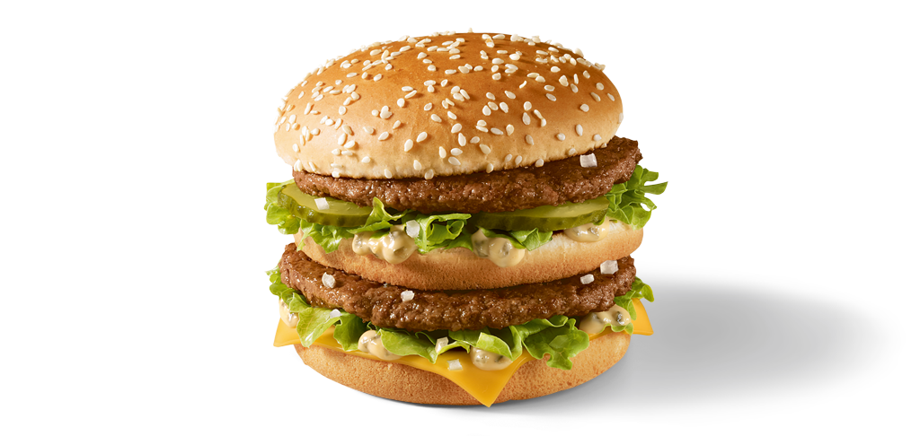
Quick detour back to method calls
foodorder1 = "Big Mac"
=> "Big Mac"
foodorder1.reverse
=> "caM giB"
foodorder1.concat(" with fries")
=> "Big Mac with fries"
Notes:
Before we look at more complicated blocks WITH variables, let’s take a quick step back and look again at method calls to better understand what we’re seeing with the iterators that work on blocks
Take a look at this for a second before I dissect the final example in the next slide.

Slide 29

Quick detour back to method calls
object receiving the method
the argument
foodorder1.concat(" with fries")
the method
Notes:
The final example we have:
The object receiving the method: “foodorder1”. We previously defined this object as the string, BIG MAC. Then we have the dot. Then the method name; concat, which will append the string WITH FRIES to the original string, BIG MAC And the argument; which is the string, ” WITH FRIES”.
As a result of this operation, we get ….

Slide 30
Quick detour back to method calls
foodorder1.concat(" with fries")
=> "Big Mac with fries"
Notes:
A Big Mac with fries…
But what if I’m ordering for my friends and want to add fries to ALL of their sandwiches, not just my one sandwich?
We’ll need a block. So now we’ll jump back and break down a block in a similar way.

Slide 31

Blocks with variables
Object receiving
the method = Array
⬇ ⬇
foodorder2 = ["Whopper", "BLT", "Veggie burger"]
Iterator
⬇
foodorder2.map do |foodorder2|
⬆ ⬆
Block opens Block variable
foodorder2.concat(" with fries")
⬆
method
end
⬆
block closes
Notes:
Here I have an array with my friends’ orders.
...the object receiving the method is the array, foodorder2. In the last example, the object was foodorder1 with a value of the string BIG MAC, and here the object is foodorder2 with a value of this array which contains 3 strings, WHOPPER, BLT, and VEGGIE BURGER
The iterator, which has the same syntax as the method call we just saw—which was concat on the object foodorder1, is map. The difference between this example and the last one is that here, this method call is followed by and applies to a block
…which starts with DO. This block is on multiple lines, so we’re using keywords do and end to delimit it.
…Right after the opening of the block at DO, we supply the block variable, within pipes ( | ).
And then we have concat method again, which will append the string WITH CHEESE to each sandwich in the array, foodorder2
And then the block closes with END

Slide 32
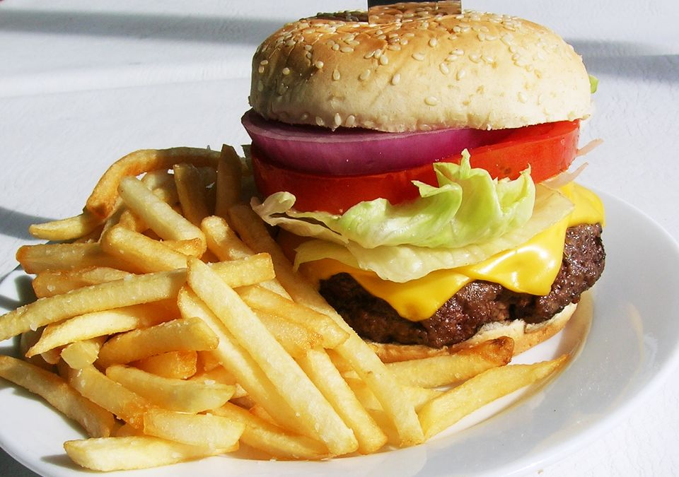
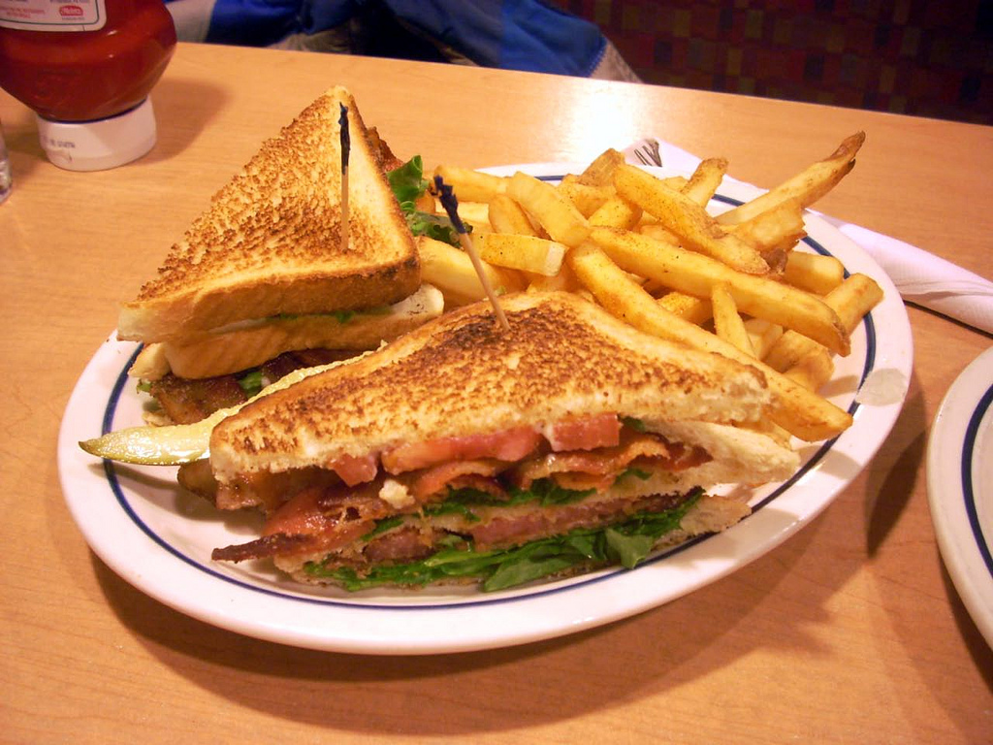
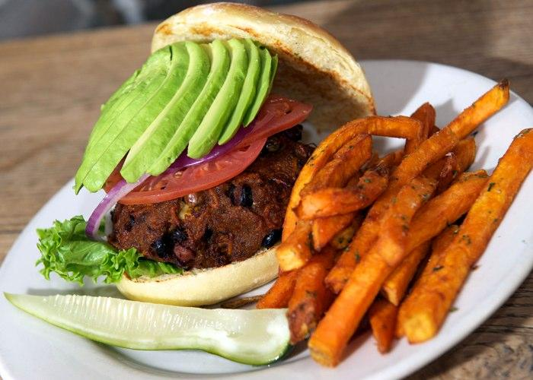
Blocks with variables
=> ["Whopper with fries", "BLT with fries", "Veggie burger with fries"]
Notes:
SO as a result of that operation, all of our sandwiches now come with fries

Slide 33
Blocks with variables
map iterator method:
(1..5).map { |i| i*2 }
=> [2, 4, 6, 8, 10]
Notes:
Here’s another example of MAP iterator method and a block.
What’s happening is that the block is executing one for each value returned by the iterator, using that value as the value for the variable.
… then the map method returns the modified elements

Slide 34
Blocks with variables
>> (1..5).each { |i| puts 2 * i }
2
4
6
8
10
=> 1..5
Notes:
This code calls the each iterator method on the range (1..5) and passes it the block: curly brace, variable “i” between pipe symbols, put-s 2 times i, curly brace
So again, the range’s each iterator method executes the block for each value in the range, and then returns the range itself.
…unlike the map method (GO BACK ONE SLIDE), which just returns the modified elements

Slide 35
Blocks with variables
(1..5).each do |boom|
puts 2 * boom
end
2
4
6
8
10
1..5
Notes:
Here’s the exact same operation using the each iterator method, but instead of curly braces we use DO and END to indicate the START and END of the block.
I’ve used “boom” inside the pipe symbols as the variable name to show that any variable name will do

Slide 36
Blocks with variables
flash = { success: "Here’s your food!", danger: "We’re all out of fries." }
{:success=>”Here’s your food!", :danger=>”We’re all out of fries."}
flash.each do |key, value|
puts "Key #{key.inspect} has value #{value.inspect}"
end
Key :success has value ”Here’s your food!"
Key :danger has value ”We’re all out of fries."
=> {:success=>”Here’s your food!", :danger=>”We’re all out of fries."}
Notes:
Here we have a hash named flash that responds to the EACH iterator method
…Before creating the block we define the keys for two conditions, key :success (with a value of the string, Great scott it worked) and key :danger (with a value of the string, run for it marty)
[[show all green text of the code, all the way to END]]
…Note: In the previous example, each method for the range, 1 to 5, took a block with only one variable, which we called boom (GO BACK ONE SLIDE AND THEN RETURN)
But here, and in all hashes, the each method takes two variables, a key and a value.
So here, the each method iterates through—or, performs an action on--the hash one key-value pair at a time…
… and then it returns the unmodified array at the end.
This example also uses the INSPECT method, which returns a string with a literal representation of the object it’s called on.
SO the result of this operation is that is has printed the strings in red:
“Key, success, has a value of the string, great scott it worked” … and “Key, danger, has a value of the string, run for it marty”

Slide 37
Some Common Iterators
.times
.each
.map OR .collect
.map!

Slide 38
More iterators
.inject, .reduce
.step, .downto, .upto
.find, .find_all, .select, .cycle
.each_slice
.chunk, .reject
.each_with_index

Slide 39
Iterators
Objects that have iterators most commonly are either:
1) Numbers
10.times { puts “We love coding!” }
1.upto(10) { |n| puts @comments[n] }
2) Collections (hashes, arrays, ranges, etc.)
flash.each {|key, value| puts "Key #{key.inspect} has value #{value.inspect}" }
foodorder2.map {|foodorder2| foodorder2.concat(" with fries")
}
(1..5).map { |i| i*2 }
Notes:
Objects that have iterators are most commonly either NUMBERS,
…As in this example where the object, or number 10, has the iterator of TIMES
…Or here where the object, or number, 1 has the iterator UPTO
Or COLLECTIONS, including hashes, arrays, and ranges
… As in this example we saw of a hash named flash (to which we already provided values not shown) that responded to the EACH iterator method…
… or with the array foodorder2 (with values also not shown) that responded to the MAP iterator method
… or with the range 1 to 5, which responded to the MAP iterator method

Slide 40
What next?
Come to a Women Who Code DC meetup!
http://www.meetup.com/Women-Who-Code-DC/
WWCDC Rails Leads:
Erin Upton-Cosulich
@ErinUptonCos
codeskillz.wordpress.com
Katherine McClintic
@scarletalphabet
Zuri Hunter
@ZuriHunter
Notes:
So that’s all for today.

